Slide 1

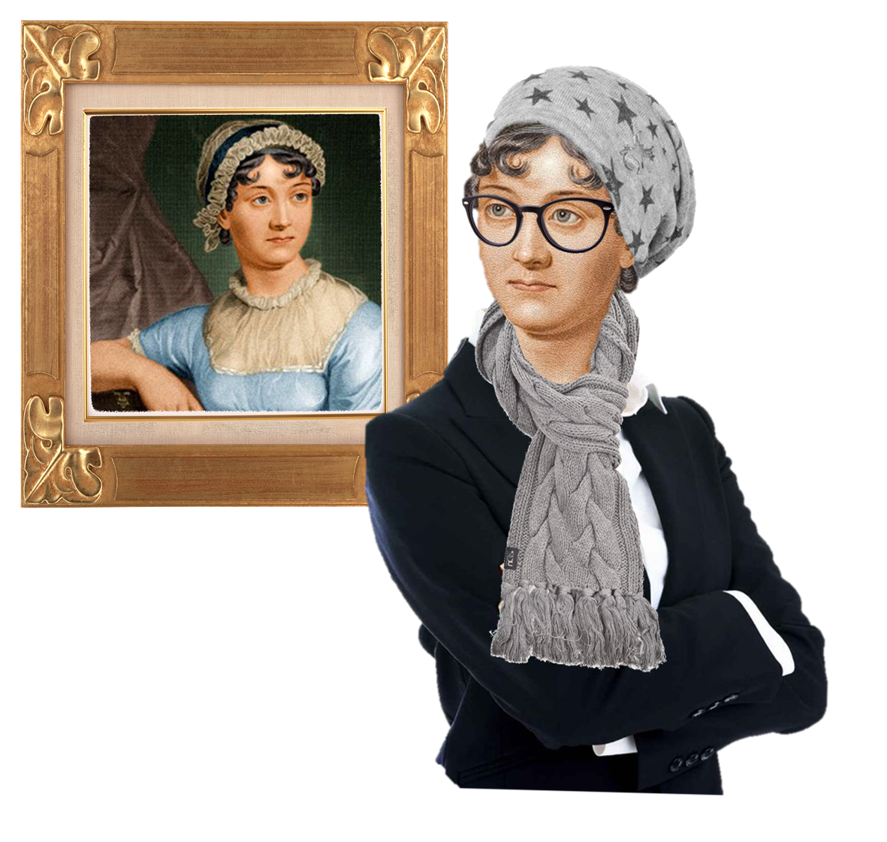
The Cultural Jane Austen
ENGL 481 – 904
Office Hours: Tuesday 12 – 1PM & Wednesdays 3 – 4 PM at LAAH 334
Ms. Kim myjungah92@tamu.edu

Slide 2
About the Instructor
Name: Jungah Kim, Ph.D. Candidate (sixth year) of English at Texas A&M University
Office: LAAH 334
Field: Victorian Literature with a focus on Material Culture
Dissertation Title: “Re-claiming (Lost) Rhythms of Life in Victorian Female Characters,” advised by Dr. Mary Ann O’Farrell
  Chapter 1: George Eliot’s Feminist Reparative Rhythms of Spinoza’s Ethics
  Chapter 2: Tools Defending (A)Sexuality in Anne Bronte’s The Tenant of Wildfell Hall
  Chapter 3: Riding Jane Eyre’s Stagecoach Rhythm within Re Jane’s New York Subway
If interested, feel free to visit my website for more information: www.myjungah92.webador.com

Slide 3
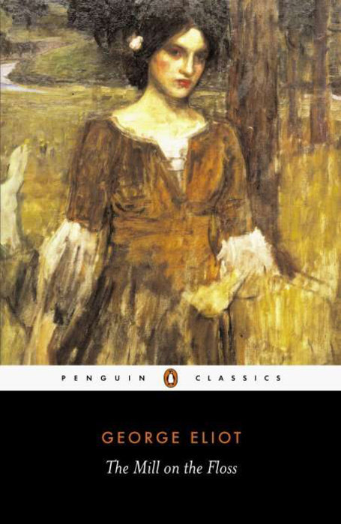
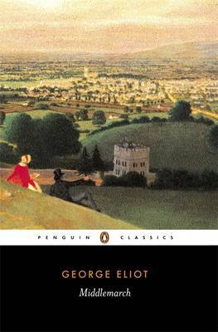
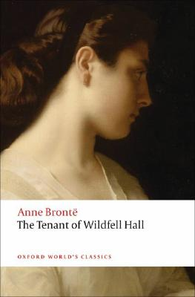
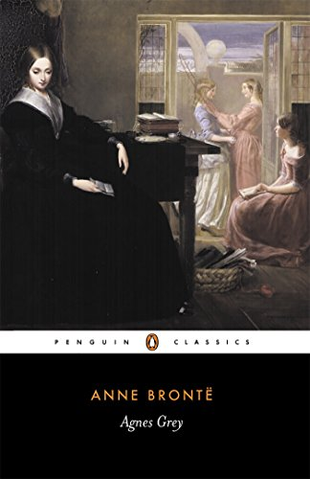
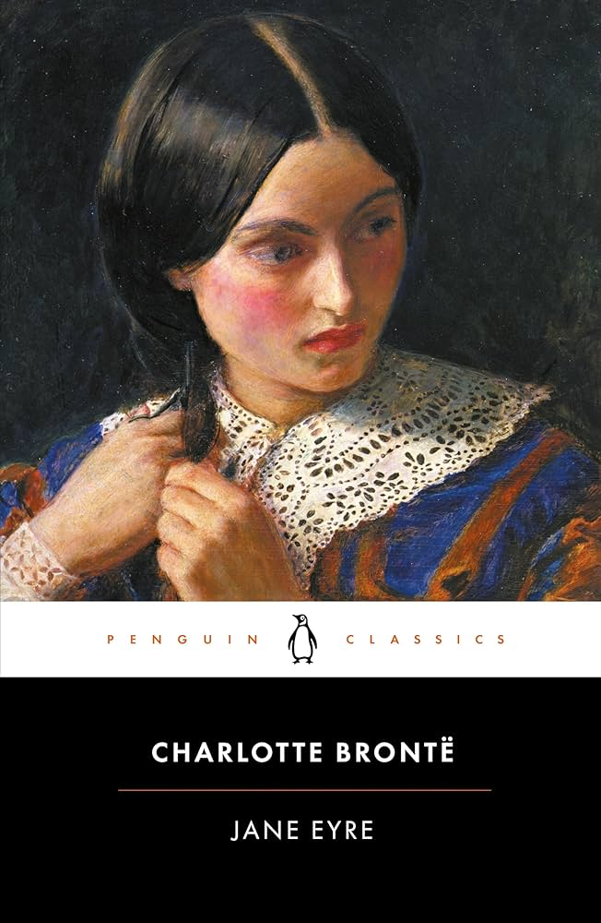

Books I incorporate into my dissertation

Slide 4
Table of Contents
Thinking through why Jane Austen adaptations are relevant to this day, especially Pride & Prejudice
Historical Context: Women, Domesticity, and the Marriage Market
Introducing Pride & Prejudice
Class Discussion on Pride and Prejudice Volume 1, Chapter 1 to Chapter 10
Group Passage Discussion

Slide 5

Why are Jane Austen Adaptations so relevant?
Relevant to today’s society for:
  Double Standards of Education between Men and Women in Education
  The Romance & The Plot
  Class Issues
  Realistic characters

Slide 6
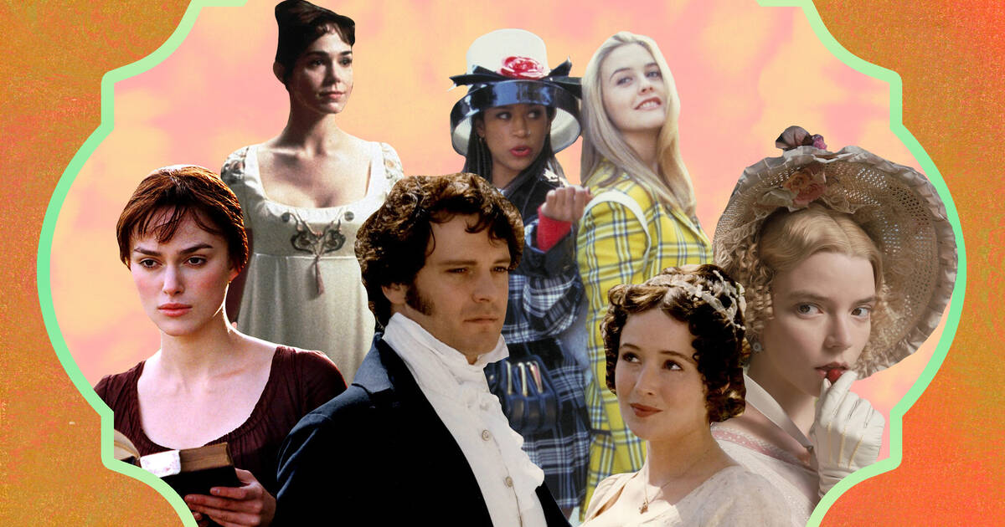

Slide 7
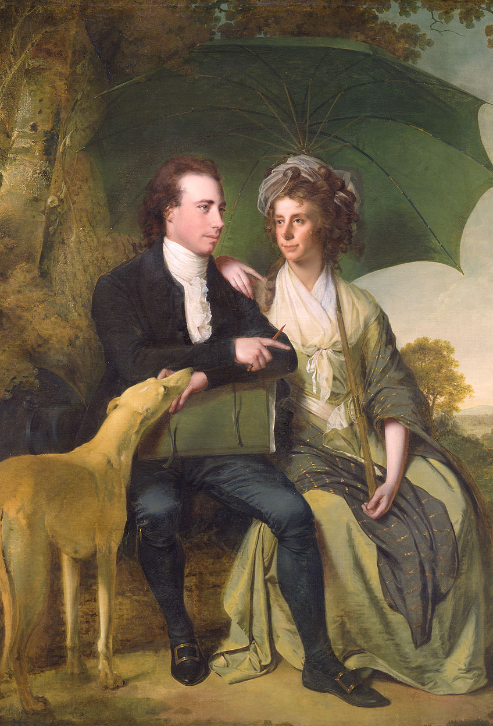
Thomas Gisborne’s Influence
Thomas Gisborne (1758 - 1846) 'the Elder' (to distinguish him from his son, the MP Thomas Gisborne the Younger) was an Anglican priest and one of the Clapham Sect, who fought for the abolition of the slave trade in England
He wrote about the role of women, particularly in An Enquiry into the Duties of the Female Sex, (1797), where he argued that women's subordinate nature is innate.
Whilst he shared the view that women should not conceal their intellectual abilities, and that parents should never force their daughters into marriage, he commended the traditional feminine virtues and the domestic role for women.
Notes:
Jane Austen knew the importance of the ideals of the clergymen, presented by Thomas Gisborne, though her relationship with the clergy was much more personal.
Jane Austen’s father, and two of her brothers were clergymen, and because of this her entire life was intimately connected with the Anglican Church. This upbringing made religious life a very big part of her daily routine, and it also made her aware of social issues involving the church, such as pluralism and tithing. These issues put a strain on the relationships between the clergy and their parishioners.

Slide 8
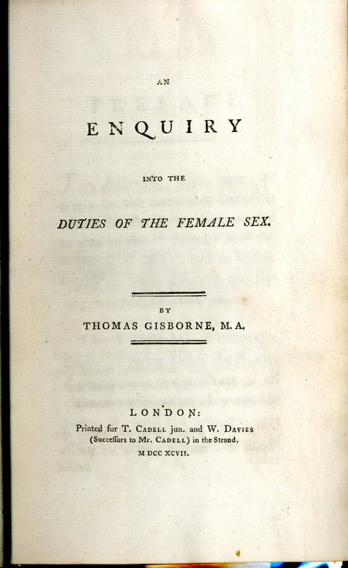
An Enquiry into the Duties of the Female Sex
“Since this period, however, it has been universally acknowledged, that the intellectual powers of women are not restricted to the arts of the housekeeper and the sempstress. Genius, taste, and learning itself, have appeared in the number of female endowments and acquisitions” (“Female Mind Discriminated” 19).
One of Scheuermann’s most valuable contributions is in lacing her analysis of Austen’s morality with specimens from contemporary moral literature like Thomas Gisborne’s An Enquiry into the Duties of Men in the Higher and Middle Classes of Society (1794). In this popular conduct book, we find the phrase “truths universally acknowledged” that Austen later applied to eligible men of fortune, but Gisborne attaches it without irony to the duties detailed in his handbook.
Austen was reading Gisborne in 1805, as she writes to her sister Cassandra: “I am glad that you recommended ‘Gisborne,’ for having begun, I am pleased with it, and I had quite determined not to read it” (30 August 1805). The most recent edition that Austen could have read would have been the sixth edition corrected, published in 1805. All subsequent references to Gisborne’s Enquiry will refer to the first edition and appear in the text

Slide 9
Themes within Pride & Prejudice
Marriage
Gender Roles
Feminism
Gentry – Class
Emotions & Rationality
Social Expectations
Education
Realism

Slide 10
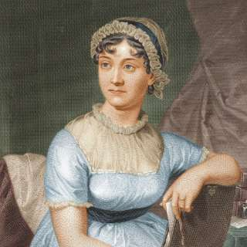
Historical Timeline
1792, A Vindication of Women’s Rights got Published
1796 – 1797 – Austen wrote ‘First Impressions’, a first version of Pride and Prejudice
1802 Austen accepted a proposal of marriage from Harris Bigg Wither, but changed her mind the following day

Slide 11
Themes within Quotations
Family Relations & Money
Mrs. Bennet & Mr. Bennet as Authorial Figures
Specificity with Money
The Gentleman
Mr. Darcy, the Gentry, Introduction
Expectations of Women
Elizabeth & Jane & Social Expectations
Everything ought to be a certain way
Narrative Styles:
Dialogue & Free Indirect Discourse
Judgement of Character
What makes a morally right person?
Women Walking:
The Meaning of Elizabeth’s Eyes & Brave Walk

Slide 12
Why are there so many characters within Pride & Prejudice?

Slide 13
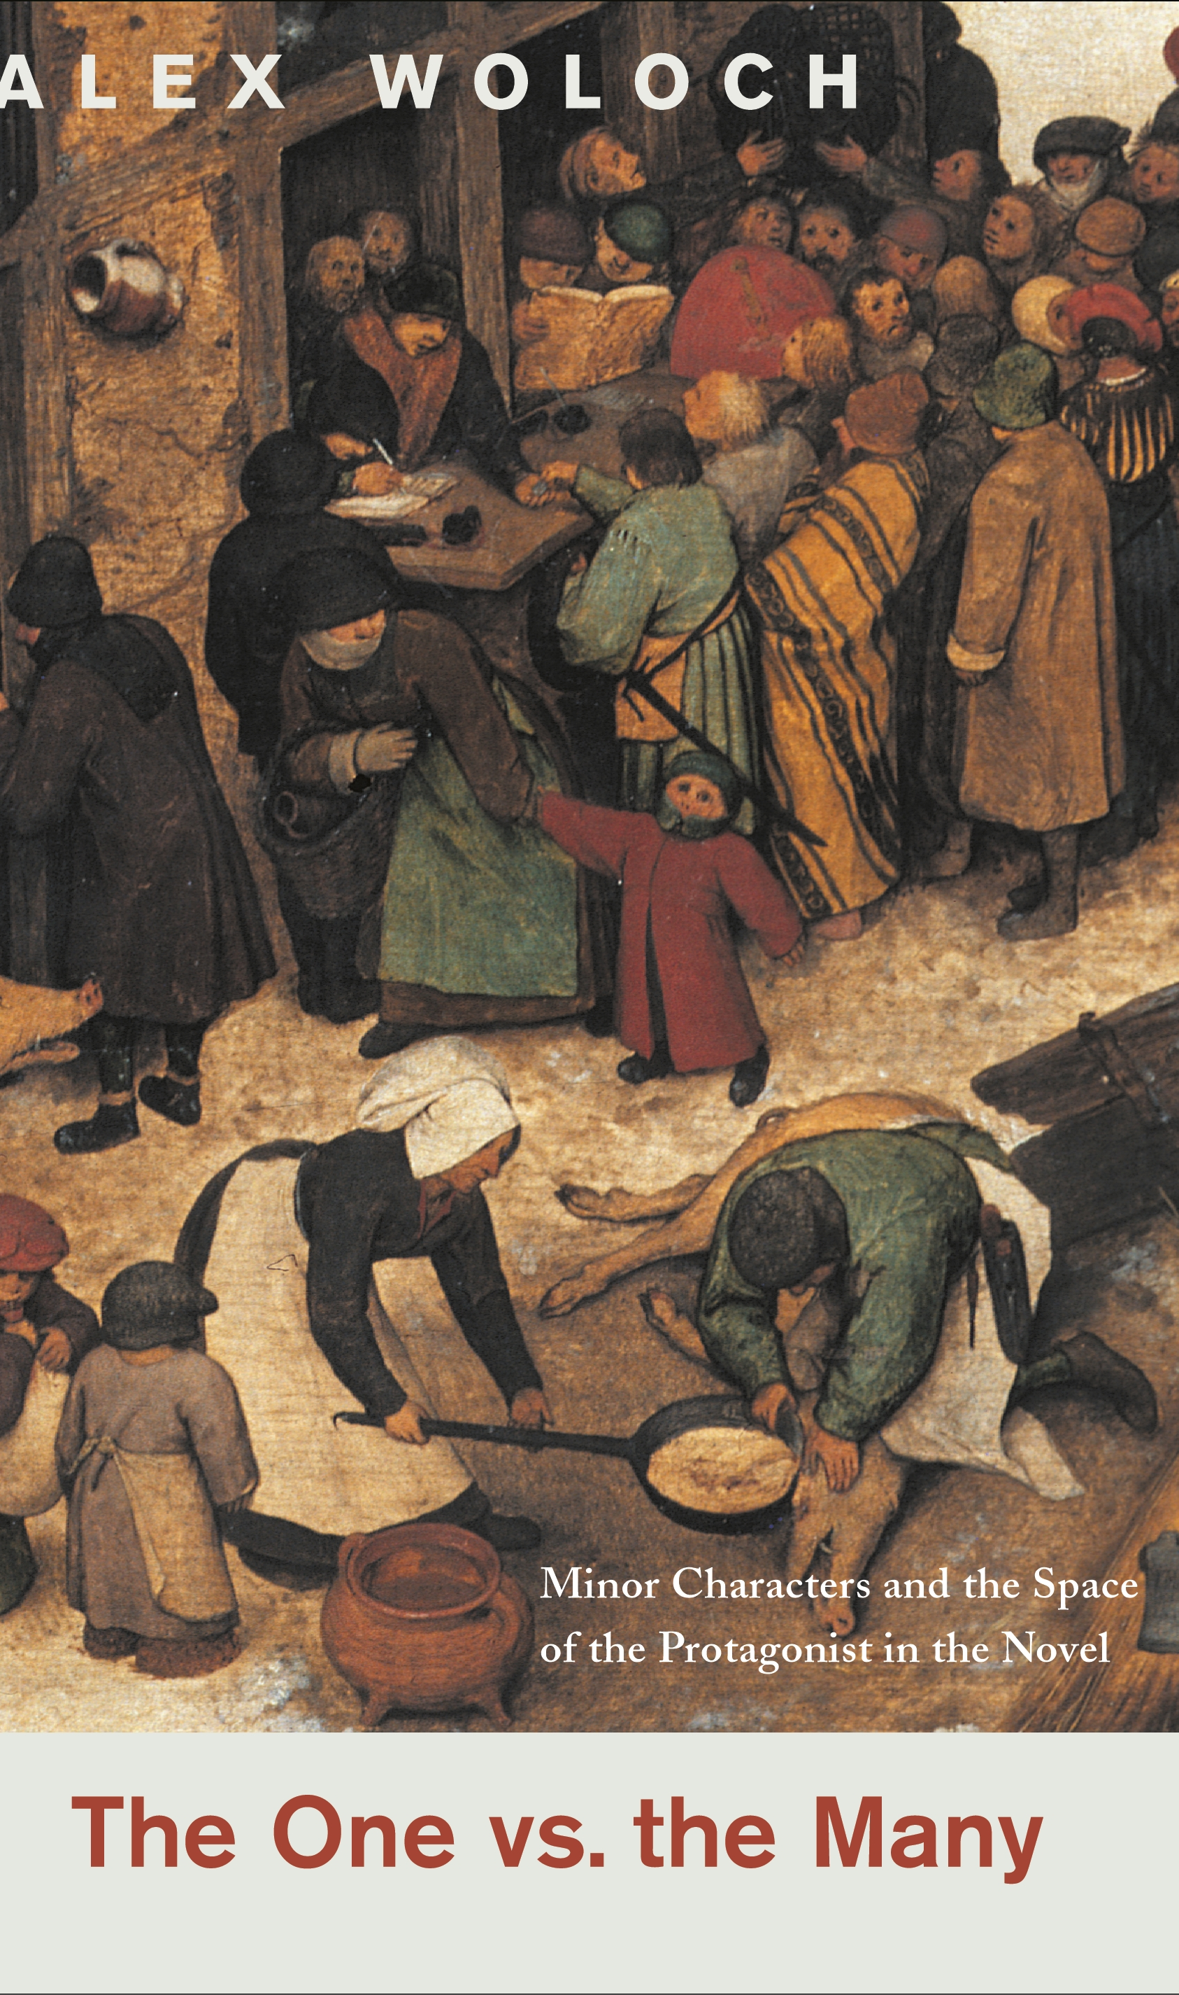
The Concept of Narrative Asymmetry
To locate the asymmetry, we can ask a basic question: if Pride & Prejudice focuses on Elizabeth Bennet because she is the most interesting and complicated character, as most critics would argue, how do we account for the lingering presence of the Bennet sisters?
Elizabeth’s sisters are a continual presence in the novel: they are a constitutive part of the symbolic structure itself, despite or, as I want to argue, because of their Minorness.
- One vs the Many by Alex Woloch

Slide 14
Character
All of [Pride and Prejudice’s] examples illustrate two different conceptions of character that coexist within Jane Austen: character as social being (a person is a character) and character as inner quality (a person has a character). The narrative structure that mediates between them is precisely asymmetry. Austen famously transforms the novel into a genre that abstracts elucidates, and diagnoses human characteristics: facilitating contrasts between inner qualities like “observation” and “temper.”
One vs the Many – Alex Woloch

Slide 15
Important passages

Slide 16
It is a truth universally acknowledged
It is a truth universally acknowledged, that a single man in possession of a good fortune must be in want of a wife.
However little known the feelings or views of such a man may be on his first entering a neighbourhood, this truth is so well fixed in the minds of the surrounding families, that he is considered as the rightful property of some one or other of their daughters.
“My dear Mr. Bennet,” said his lady to him one day, “have you heard that Netherfield Park is let at last?{=”
Mr. Bennet replied that he had not.
“But it is,” returned she; “for Mrs. Long has just been here, and she told me all about it.”
Mr. Bennet made no answer.
“Do not you want to know who has taken it?” cried his wife, impatiently.
“You want to tell me, and I have no objection to hearing it.” (p.6)
Discussion Question: Why does the novel start with the introduction of Mr. Bennet & Mrs. Bennet and their discussion on marriage? What do you notice about the language?

Slide 17
Family Relations & Money

Slide 18
Family Relations & Money
Mr. Bennet & Mrs. Bennet [Opening]
Why is Mr. and Mrs. Bennet characterized in this way?
Mr. Bennet’s Property
Why is there an emphasis on Mr. Bennet’s property?

Slide 19
Mr. Bennet & Mrs. Bennet
Mr. Bennet was so odd a mixture of quick parts, sarcastic humour, reserve, and caprice, that the experience of three-and-twenty years had been insufficient to make his wife understand his character. Her mind was less difficult to develop. She was a woman of mean understanding, little information, and uncertain temper. When she was discontented, she fancied herself nervous. The business of her life was to get her daughters married: its solace was visiting and news.
Discussion Question: Why is Mr. and Mrs. Bennet characterized in this way?

Slide 20
Mr. Bennet’s Property
MR. BENNET’S property consisted almost entirely in an estate of two thousand a year, which, unfortunately for his daughters, was entailed, in default of heirs male, on a distant relation; and their mother’s fortune, though ample for her situation in life, could but ill supply the deficiency of his. Her father had been an attorney in Meryton, and had left her four thousand pounds (29)
Discussion Question: Why is there an emphasis on Mr. Bennet’s property?

Slide 21
The Marriage Question

Slide 22
The Question of Marriage
Not all that Mrs. Bennet, however, with the assistance of her five daughters, could ask on the subject, was sufficient to draw from her husband any satisfactory description of Mr. Bingley. They attacked him in various ways, with barefaced questions, ingenious suppositions, and distant surmises; but he eluded the skill of them all; and they were at last obliged to accept the second-hand intelligence of their neighbour, Lady Lucas. Her report was highly favourable. Sir William had been delighted with him. He was quite young, wonderfully handsome, extremely agreeable, and, to crown the whole, he meant to be at the next assembly with a large party. Nothing could be more delightful! To be fond of dancing was a certain step towards falling in love; and very lively hopes of Mr. Bingley’s heart were entertained.
“If I can but see one of my daughters happily settled at Netherfield,” said Mrs. Bennet to her husband, “and all the others equally well married, I shall have nothing to wish for.”
Discussion Question: What do you think of the emphasis on marriage in P&P? What does it reflect about the time period and on gender?

Slide 23
Gentleman

Slide 24
Mr. Bingley
Mr. Bingley was good-looking and gentlemanlike: he had a pleasant countenance, and easy, unaffected manners. His sisters were fine women, with an air of decided fashion. His brother-in-law, Mr. Hurst, merely looked the gentleman; but his friend Mr. Darcy soon drew the attention of the room by his fine, tall person, handsome features, noble mien, and the report, which was in general circulation within five minutes after his entrance, of his having ten thousand a year. The gentlemen pronounced him to be a fine figure of a man, the ladies declared he was much handsomer than Mr. Bingley, and he was looked at with great admiration for about half the evening, till his manners gave a disgust which turned the tide of his popularity; for he was discovered to be proud, to be above his company, and above being pleased; and not all his large estate in Derbyshire could save him from having a most forbidding, disagreeable countenance, and being unworthy to be compared with his friend (12)
Discussion Question: What characteristics do you notice about Mr. Bingley?

Slide 25
Mr. Bingley & Mr. Darcy
Mr. Bingley had soon made himself acquainted with all the principal people in the room: he was lively and unreserved, danced every dance, was angry that the ball closed so early, and talked of giving one himself at Netherfield. Such amiable qualities must speak for themselves. What a contrast between him and his friend! Mr. Darcy danced only once with Mrs. Hurst and once with Miss Bingley, declined being introduced to{14} any other lady, and spent the rest of the evening in walking about the room, speaking occasionally to one of his own party. His character was decided. He was the proudest, most disagreeable man in the world, and everybody hoped that he would never come there again. Amongst the most violent against him was Mrs. Bennet, whose dislike of his general behaviour was sharpened into particular resentment by his having slighted one of her daughters.
Discussion Question: Why does the author decide to compare the two?

Slide 26
Darcy & Bingley
Between him and Darcy there was a very steady friendship, in spite of a great opposition of character. Bingley was endeared to Darcy by the easiness, openness, and ductility of his temper, though no disposition could offer a greater contrast to his own, and though with his own he never appeared dissatisfied. On the strength of Darcy’s regard, Bingley had the firmest reliance, and of his judgment the highest opinion. In understanding, Darcy was the superior. Bingley was by no means deficient; but Darcy was clever. He was at the same time haughty, reserved, and fastidious; and his manners, though well bred, were not inviting. In that respect his friend had greatly the advantage. Bingley was sure of being liked wherever he appeared; Darcy was continually giving offence (18)
Discussion Question: Is it an equal friendship?

Slide 27
Mr. Darcy & Elizabeth
Which do you mean?” and turning round, he looked for a moment at Elizabeth, till, catching her eye, he withdrew his own, and coldly said, “She is tolerable: but not handsome enough to tempt me; and I am in no humour at present to give consequence to young ladies who are slighted by other men. You had better return to your partner and enjoy her smiles, for you are wasting your time with me.”
Mr. Bingley followed his advice. Mr. Darcy walked off; and Elizabeth remained with no very cordial feelings towards him. She told the story, however, with great spirit among her friends; for she had a lively, playful disposition, which delighted in anything ridiculous. (13)
Discussion Question: What do you notice about Mr. Darcy & Elizabeth’s characterization?

Slide 28
Manners
The manner in which they spoke of the Meryton assembly was sufficiently characteristic. Bingley had never met with pleasanter people or prettier girls in his life; everybody had been most kind and attentive to him; there had been no formality, no stiffness; he had soon felt acquainted with all the room; and as to Miss Bennet, he could not conceive an angel more beautiful. Darcy, on the contrary, had seen a collection of people in whom there was little beauty and no fashion, for none of whom he had felt the smallest interest, and from none received either attention or pleasure. Miss Bennet he acknowledged to be pretty; but she smiled too much (18)
Discussion Question: Is there a undertone on class? If so, how?

Slide 29
Jane & Elizabeth
“He is just what a young-man ought to be,” said she, “sensible, good-humoured, lively; and I never saw such happy manners! so much ease, with such perfect good breeding!”
“He is also handsome,” replied Elizabeth, “which a young man ought likewise to be if he possibly can. His character is thereby complete.”
“I was very much flattered by his asking me to dance a second time. I did not expect such a compliment.”
“Did not you? I did for you. But that is one great difference between us. Compliments always take you by surprise, and me never. What could be more natural than his asking you again? He could not help seeing that you{19} were about five times as pretty as every other woman in the room. No thanks to his gallantry for that. Well, he certainly is very agreeable, and I give you leave to like him. You have liked many a stupider person.”
Discussion Question: How do the two serve as foils to one another?

Slide 30
Social Expectations of Women

Slide 31
Social Expectations of Women
What a Woman Must Be
Charlotte Lucas’s Thoughts
Mary
The Nonexistent Woman

Slide 32
What a Woman Must be
It may, perhaps, be pleasant,” replied Charlotte, “to be able to impose on the public in such a case; but it is sometimes a disadvantage to be so very guarded. If a woman conceals her affection with the same skill from the object of it, she may lose the opportunity of fixing him; and it will then be but poor consolation to believe the world equally in the dark. There is so much of gratitude or vanity in almost every attachment, that it is not safe to leave any to itself. We can all begin freely—a slight preference is natural enough; but there are very few of us who have heart enough to be really in love without encouragement. In nine cases out of ten, a woman had better show more affection than she feels. Bingley likes your sister undoubtedly; but he may never do more than like her, if she does not help him on.”
“But she does help him on, as much as her nature will allow. If I can perceive her regard for him, he must be a simpleton indeed not to discover it too.” (22)
Discussion Question: How does Charlotte understand what woman should be?

Slide 33
Charlotte Lucas’s Thought
“Well,” said Charlotte, “I wish Jane success with all my heart; and if she were married to him to-morrow, I should think she had as good a chance of happiness as if she were to be studying his character for a twelvemonth. Happiness in marriage is entirely a matter of chance. If the dispositions of the parties are ever so well known to each other, or ever so similar beforehand, it does not advance their felicity in the least. They always continue to grow sufficiently unlike afterwards to have their share of vexation; and it is better to know as little as possible of the defects of the person with whom you are to pass your life.”
“You make me laugh, Charlotte; but it is not sound. You know it is not sound, and that you would never act in this way yourself.” (24)
Discussion Question: What kind of commentary is there on Charlotte Lucas?

Slide 34
Mary
Her performance was pleasing, though by no means capital. After a song or two, and before she could reply to the entreaties of several that she would sing again, she was eagerly succeeded at the instrument by her sister Mary, who having, in consequence of being the only plain one in the family, worked hard for knowledge and accomplishments, was always impatient for display.
Mary had neither genius nor taste; and though vanity had given her application, it had given her likewise a pedantic air and conceited manner, which would have injured a higher degree of excellence than she had reached. Elizabeth, easy and unaffected, had been listened to with much more pleasure, though not playing half so well; and Mary, at the end of a long concerto, was glad to purchase praise and gratitude by Scotch and Irish airs, at the request of her younger sisters, who with some of the Lucases, and two or three officers, joined eagerly in dancing at one end of the room (25)
Discussion Question: What does Mary represent as a character in this realm of characters?

Slide 35
The Nonexistent Woman
“Oh, certainly,” cried his faithful assistant, “no one can be really esteemed accomplished who does not greatly surpass what is usually met with. A woman must have a thorough knowledge of music, singing, drawing, dancing, and the modern languages, to deserve the word; and, besides all this, she must possess a certain something in her air and manner of walking, the tone of her voice, her address and expressions, or the word will be but half deserved.”
“All this she must possess,” added Darcy; “and to all she must yet add something more substantial in the improvement of her mind by extensive reading.”
“I am no longer surprised at your knowing only six accomplished women. I rather wonder now at your knowing any.”
“Are you so severe upon your own sex as to doubt the possibility of all this?”
“I never saw such a woman. I never saw such capacity, and taste, and application, and elegance, as you describe, united.” (39)
Discussion Question: What do you notice about their commentary?

Slide 36
The Walking Women

Slide 37
Elizabeth & Walking
Elizabeth, feeling really anxious, determined to go to her, though the carriage was not to be had: and as she was no horsewoman, walking was her only alternative. She declared her resolution.
“How can you be so silly,” cried her mother, “as to think of such a thing, in all this dirt! You will not be fit to be seen when you get there.”
“I shall be very fit to see Jane—which is all I want.” (32)
Discussion Question: What might potentially be deduced by Elizabeth walking in the nineteenth century?

Slide 38
Walking & Talking
“To walk three miles, or four miles, or five miles, or whatever it is, above her ankles in dirt, and alone, quite alone! what could she mean by it? It seems to me to show an abominable sort of conceited independence, a most country-town indifference to decorum.”
“It shows an affection for her sister that is very pleasing,” said Bingley.
“I am afraid, Mr. Darcy,” observed Miss Bingley, in a half whisper, “that this adventure has rather affected your admiration of her fine eyes.”
“Not at all,” he replied: “they were brightened by the exercise.” A short pause followed this speech, and Mrs. Hurst began again,— (36)
Discussion Question: Why do the upper class women not approve of Elizabeth walking?

Slide 39
Pride

Slide 40
Definitions of Pride
“His pride,” said Miss Lucas, “does not offend me so much as pride often does, because there is an excuse for it. One cannot wonder that so very fine a young man, with family, fortune, everything in his favour, should think highly of himself. If I may so express it, he has a right to be proud.”
“That is very true,” replied Elizabeth, “and I could easily forgive his pride, if he had not mortified mine.”
“Pride,” observed Mary, who piqued herself upon the solidity of her reflections, “is a very common failing, I believe. By all that I have ever read, I am convinced that it is very common indeed; that human nature is particularly prone to it, and that there are very few of us who do not cherish a feeling of self-complacency on the score of some quality or other, real or imaginary. Vanity and pride are different things, though the words are often{26} used synonymously. A person may be proud without being vain. Pride relates more to our opinion of ourselves; vanity to what we would have others think of us.” (21)
Discussion Question: What do you notice about each women’s take on pride?

Slide 41
Narrative Styles

Slide 42
FID
Occupied in observing Mr. Bingley’s attention to her sister, Elizabeth was far from suspecting that she was herself becoming an object of some interest in the eyes of his friend. Mr. Darcy had at first scarcely allowed her to be pretty: he had looked at her without admiration at the ball; and when they next met, he looked at her only to criticise. But no sooner had he made it clear to himself and his friends that she had hardly a good feature in her face, than he began to find it was rendered uncommonly intelligent by the beautiful expression of her dark eyes. To this discovery succeeded some others equally mortifying. Though he had detected with a critical eye more than one failure of perfect symmetry in her form, he was forced to acknowledge her figure to be light and pleasing; and in spite of his asserting that her manners were not those of the fashionable world, he was caught by their easy playfulness. Of this she was perfectly unaware: to her he was only the man who made himself agreeable nowhere, and who had not thought her handsome enough to dance with (24)
Discussion Question: What do you notice about their interaction?

Slide 43
Narrative Intrusion
Elizabeth listened in silence, but was not convinced: their behaviour at the assembly had not been calculated to please in general; and with more quickness of observation and less pliancy of temper than her sister, and with a judgment, too, unassailed by any attention to herself, she was very little disposed to approve them. They were, in fact, very fine ladies; not deficient in good-humour when they were pleased, nor in the power of being agreeable where they chose it; but proud and conceited. They were rather handsome; had been educated in one of the first private seminaries in town; had a fortune of twenty thousand pounds; were in the habit of spending more than they ought, and of associating with people of rank; and were, therefore, in every respect entitled to think well of themselves and meanly of others. They were of a respectable family in the north of England; a circumstance more deeply impressed on their memories than that their brother’s fortune and their own had been acquired by trade. (17)
Discussion Question: Why is there a particular narrative intrusion here, particularly on money?

Slide 44
Group Discussion

