Slide 1

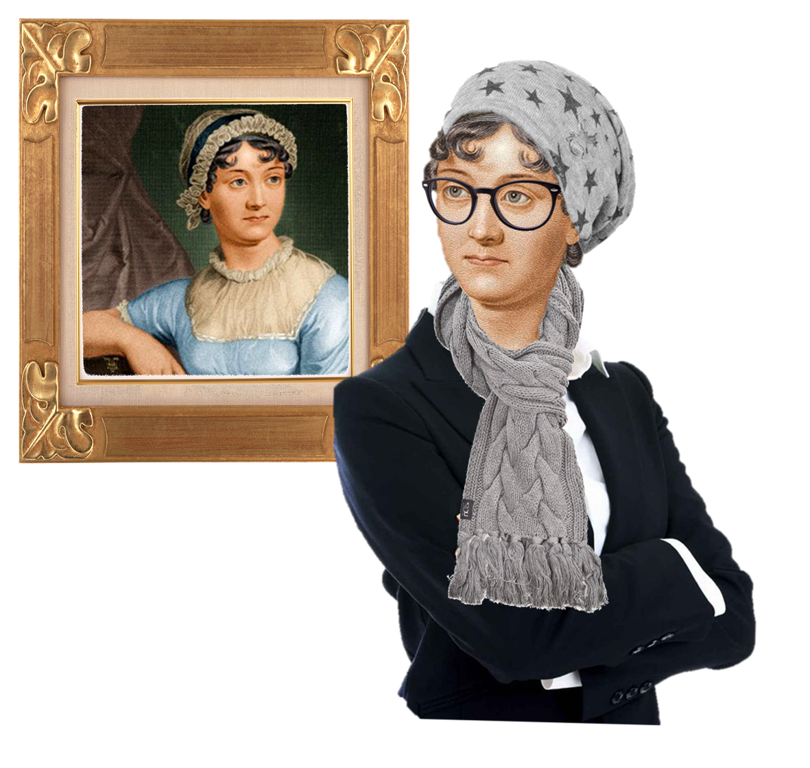
The Cultural Jane Austen
ENGL 481 – 904
Office Hours: Tuesday 12 – 1PM & Wednesdays 3 – 4 PM at LAAH 334
Ms. Kim myjungah92@tamu.edu

Slide 2
Table of Contents
Recap
Reminder for Close Reading Paper
Volume 3 Discussion
Nature
Blush (Body & Language)
Precocious Children & Childish Adults
The Ending

Slide 3
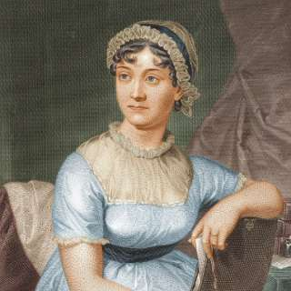
Historical Timeline
1792, A Vindication of Women’s Rights got Published
1796 – 1797 – Austen wrote ‘First Impressions’, a first version of Pride and Prejudice
1802 Austen accepted a proposal of marriage from Harris Bigg Wither, but changed her mind the following day

Slide 4
Character
All of [Pride and Prejudice’s] examples illustrate two different conceptions of character that coexist within Jane Austen: character as social being (a person is a character) and character as inner quality (a person has a character). The narrative structure that mediates between them is precisely asymmetry. Austen famously transforms the novel into a genre that abstracts elucidates, and diagnoses human characteristics: facilitating contrasts between inner qualities like “observation” and “temper.”
One vs the Many – Alex Woloch

Slide 5
Character defined by the OED
Moral and mental qualities strongly developed or strikingly displayed; distinct or distinguished personality.
The sum of the moral and mental qualities which distinguish an individual or a people, viewed as a homogeneous whole; a person's or group's individuality deriving from environment, culture, experience, etc.; mental or moral constitution, personality.
Personality, esp. strong personality, as suggested by an aspect of a person's appearance, or in a representation of a person.

Slide 6
Free Indirect Discourse (FID)
Free indirect discourse (FID) is a narrative technique in which the narrator’s third-person voice is infused with the first-person voice of the character without indicators, such as "she said" or "I thought.
The narrator has access to the thoughts and feelings of the characters and describes these to the reader. The narrator of the novel also frequently adds commentary about characters and their actions, which shapes the reader’s perception.
For example, at the start of the novel the narrator describes Mrs. Bennet as “a woman of mean understanding, little information, and uncertain temper.” Although the narrator has access to every character’s interior life, the novel’s events are usually told from Elizabeth’s point of view.
Austen or “narrator” that intrudes and gives their own thoughts on what’s happening → form of social commentary

Slide 7
Themes within Quotation
Pemberley & Nature
Significance of Nature
Significance of the Blush
Precocious Children & Childish Adults
Body vs Language
Money Talks
Austen’s Laugh
The Ending

Slide 8
Important passages

Slide 9
Pemberley & Nature

Slide 10
What is the effect of going to Pemberley?
What does it show about Darcy?

Slide 11
Pemberley
Elizabeth’s mind was too full for conversation, but she saw and admired every remarkable spot and point of view. They gradually ascended for half a mile, and then found themselves at the top of a considerable eminence, where the wood ceased, and the eye was instantly caught by Pemberley House, situated on the opposite side of a valley, into which the road with some abruptness wound. It was a large, handsome, stone building, standing well on rising ground, and backed by a ridge of high woody hills;—and in front, a stream of some natural importance was swelled into greater, but without any artificial appearance.* Its banks were neither formal, nor falsely adorned. Elizabeth was delighted. She had never seen a place for which nature had done more, or where natural beauty had been so little counteracted by an awkward taste. They were all of them warm in their admiration; and at that moment she felt, that to be mistress of Pemberley might be something! (p.235, Oxford p.181)
Discussion Question: Why is there so much association to nature and Pemberley?
beautiful house
Darcy himself - taste & character & rich
socioeconomic background of Elizabeth = very impressed by what Darcy has done with his money
able to acknowledge of the beauty [notes the differences]
humbly elegant / class
Elizabeth = looking for balance / not being sure of the “grasp” of money / but now can visualize how Darcy could use that money

Slide 12
The Housekeeper
The housekeeper came; a respectable-looking, elderly woman, much less fine, and more civil, than she had any notion of finding her. They followed her into the dining-parlour. It was a large, well-proportioned room, handsomely fitted up. Elizabeth, after slightly surveying it, went to a window to enjoy its prospect. The hill, crowned with wood, from which they had descended, receiving increased abruptness from the distance, was a beautiful object. Every disposition of the ground was good; and she looked on the whole scene, the river, the trees scattered on its banks, and the winding of the valley, as far as she could trace it, with delight. As they passed into other rooms, these objects were taking different positions; but from every window there were beauties to be seen. The rooms were lofty and handsome, and their furniture suitable to the fortune of their proprietor; but Elizabeth saw with admiration of his taste, that it was neither gaudy nor uselessly fine; with less of splendor, and more real elegance, than the furniture of Rosings. (p.236, Oxford p.182)
Discussion Question: Why is the housekeeper described so much in a positive light and what is the role of the housekeeper in the house, as a character?
good judge of opinion / housekeeper = sound opinion / jolly way / land-owner
Proof of Darcy - goodwill/equating Darcy = Family / Family hypothetically be part of
Goodwill
Biblical Allusions / simple & elegant & it was good / Darcy’s will to create
Acknowledging / accept Darcy could be a good thing (family heritage)
Housekeeper = elderly women (wise) / mother&maiden

Slide 13
The Gardener
When all of the house that was open to general inspection had been seen, they returned down stairs, and taking leave of the housekeeper, were consigned over to the gardener, who met them at the hall door.
As they walked across the lawn towards the river, Elizabeth turned back to look again; her uncle and aunt stopped also, and while the former was conjecturing as to the date of the building, the owner of it himself suddenly came forward from the road, which led behind it to the stables.
They were within twenty yards of each other, and so abrupt was his appearance, that it was impossible to avoid his sight. Their eyes instantly met, and the cheeks of each were overspread with the deepest blush. He absolutely started, and for a moment seemed immoveable from surprise; but shortly recovering himself, advanced towards the party, and spoke to Elizabeth, if not in terms of perfect composure, at least of perfect civility. (p.240, Oxford p.185-186)
Discussion Question: Why is there a shift from the Gardiners to the Gardener? Is it on purpose? If so, why?
caretaker = Gardener / making things happen / seeds
emphasizes so little of athe appearance vs Darcy [hanging out at the stables] / paints him in a personal light/personal with his employment / trusts the employees like the gardener / less pompous in his estate
Gardener/Mr&Mrs.Gardiner = making them look better in each other’s eyes
Re-introduces Mr. Darcy in a new light/shows his humility/prideful - how he is in the comfort of his own home
Stuck in this moment
Feelings - younger than they are / “innocence”
“Knowledge” - blush as a form that speaks for them
Blush = realistic portrayal of the body
Understanding of one another => allows them to be vulnerable / post-eating the apple [knowledge] / finally acknowledging their feelings against society

Slide 14
A Sudden Turn
There was certainly at this moment, in Elizabeth’s mind, a more gentle sensation towards the original, than she had ever felt in the height of their acquaintance. The commendation bestowed on him by Mrs. Reynolds was of no trifling nature. What praise is more valuable than the praise of an intelligent servant? As a brother, a landlord, a master, she considered how many people’s happiness were in his guardianship!—How much of pleasure or pain it was in his power to bestow!—How much of good or evil must be done by him! Every idea that had been brought forward by the housekeeper was favourable to his character, and as she stood before the canvas, on which he was represented, and fixed his eyes upon herself, she thought of his regard with a deeper sentiment of gratitude than it had ever raised before; she remembered its warmth, and softened its impropriety of expression (p.240, Oxford p.185)
Discussion Question: Is there a bias in Elizabeth’s tone?

Slide 15
Internal Dialogue
The others then joined her, and expressed their admiration of his figure; but Elizabeth heard not a word, and, wholly engrossed by her own feelings, followed them in silence. She was overpowered by shame and vexation. Her coming there was the most unfortunate, the most ill-judged thing in the world! How strange must it appear to him! In what a disgraceful light might it not strike so vain a man! It might seem as if she had purposely thrown herself in his way again! Oh! why did she come? or, why did he thus come a day before he was expected? Had they been only ten minutes sooner, they should have been beyond the reach of his discrimination, for it was plain that he was that moment arrived, that moment alighted from his horse or his carriage. She blushed again and again over the perverseness of the meeting. And his behaviour, so strikingly altered,—what could it mean? That he should even speak to her was amazing!—but to speak with such civility, to enquire after her family! Never in her life had she seen his manners so little dignified, never had he spoken with such gentleness as on this unexpected meeting. What a contrast did it offer to his last address in Rosing’s Park, when he put his letter into her hand! She knew not what to think, nor how to account for it. (241, Oxford p. 187)
Discussion Question: In what way is Elizabeth humbled by her entrance to Darcy’s home?

Slide 16
Significance of nature?
https://docs.google.com/document/d/1eRaNijUS0HWp_U4fUN23wrhyJv96zYvr/edit?usp=sharing&ouid=112105515215870259222&rtpof=true&sd=true

Slide 17
Significance of the Blush

Slide 18
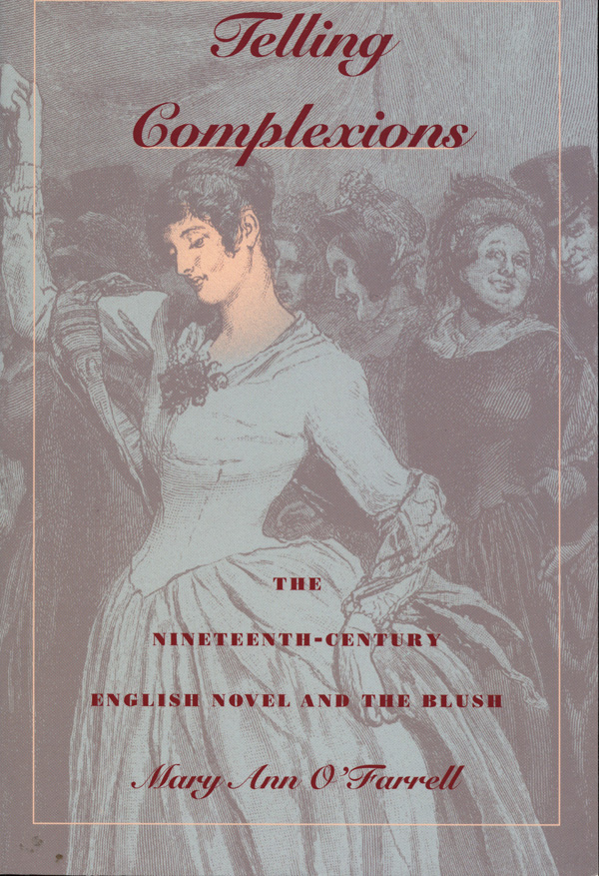
Telling Complexions, Dr. O’Farrell
When Lewes writes, then, of Jane Austen’s flawed sense of the body’s relations, he fails to see that its “connections,” as she registers them, are more “subtle” than the connections he imagines she misses.
If Jane Austen minimizes the bodily dimension, her mode is mortification own mode of diminishment by reminder. Pride and Prejudice describes, evokes, demands the bodily response that is blushing; and when the novel gets the response it demands, it does so because it understand - because Austen understands - that those of us who blush believe, with pain and pleasure, in the tales their blushes tell. And, in turn, our belief that our blushes are able to reveal our truths supports the social and textual systems that generate them for circulation.
Finding pleasure in embarrassment and mortification, we seem to find it in the romance of the involuntary; but, like Pride and Prejudice itself, we may have learned to take our pleasures where we find them - even if in the satisfying and reduplicating pleasures where we find them - even if in the satisfying and reduplicating self-consciousness of our suspicion that the tale told by our blushes may be only the narrative of our bodies’ inevitable fulfillment of their social obligations (26)
Telling Complexions by Dr. O’Farrell

Slide 19
Blush
caught at Pemberley (after rejecting Mr. Darcy) / you feel together with Elizabeth
George Henry Lewes → flawed idea of woman’s bodies
Mr. Darcy & Elizabeth blush at the same time / men don’t blush (stereotype) / implies – it wasn’t a cold feeling / Mr. Collins
He loves her so much = blushing to show his own emotions

Slide 20
The Gentleman and Stroke of Civility
With a glance she saw, that he had lost none of his recent civility; and, to imitate his politeness, she began, as they met, to admire the beauty of the place; but she had not got beyond the words ‘delightful,’ and ‘charming,’ when some unlucky recollections obtruded, and she fancied that praise of Pemberley from her, might be mischievously construed. Her colour changed, and she said no more (p. 243, Oxford p.188)
Discussion Question: What is the blush telling?

Slide 21
Austen Teasing
‘Yes,’ replied Darcy, who could contain himself no longer, ‘but that was only when I first knew her, for it is many months since I have considered her as one of the handsomest women of my acquaintance.’
He then went away, and Miss Bingley was left to all the satisfaction of having forced him to say what gave no one any pain but herself. (p.259, Oxford p. 201)
Discussion Question: In what way does Austen tease her audience?

Slide 22
Her Power was Sinking
Darcy made no answer. He seemed scarcely to hear her, and was walking up and down the room in earnest meditation; his brow contracted, his air gloomy. Elizabeth soon observed, and instantly understood it. Her power was sinking; every thing must sink under such a proof of family weakness, such an assurance of the deepest disgrace. She could neither wonder nor condemn, but the belief of his self-conquest brought nothing consolatory to her bosom, afforded no palliation of her distress. It was, on the contrary, exactly calculated to make her understand her own wishes; and never had she so honestly felt that she could have loved him, as now, when all love must be vain (p.264, Oxford p.206)
Discussion Question: What does Austen mean by how her power was sinking?

Slide 23
Mary’s Commentary
‘This is a most unfortunate affair; and will probably be much talked of. But we must stem the tide of malice, and pour into the wounded bosoms of each other, the balm of sisterly consolation.’
Then, perceiving in Elizabeth no inclination of replying, she added, ‘Unhappy as the event must be for Lydia, we may draw from it this useful lesson; that loss of virtue in a female is irretrievable—that one false step involves her in endless ruin—that her reputation is no less brittle than it is beautiful,—and that she cannot be too much guarded in her behaviour towards the undeserving of the other sex.’
Elizabeth lifted up her eyes in amazement, but was too much oppressed to make any reply. Mary, however, continued to console herself with such kind of moral extractions from the evil before them. (p.274, Oxford p. 214)
Discussion Question: Why does Mary make such a commentary? What kind of role does she play in the novel and from the sisters?
tells things how it is = truth / realistic aspects of the world (what she believes to be)
sarcasm is also there / this is what it is for women / disgusted tone / closeted poetical sister
Most accomplished girl from Mr. Bingley / subversive of going against gender norms
Women can learn → raise awareness of what women can possibly do
Feminist commentary on how women can be something else than what they are meant for (domestic housewife marrying within their classes)
Secret “girl” code / allowing women to pick up on these ideas

Slide 24
Precocious Children and Childish Adults

Slide 25
The Failed Father
THE whole party were in hopes of a letter from Mr. Bennet the next morning, but the post came in without bringing a single line from him. His family knew him to be on all common occasions, a most negligent and dilatory correspondent, but at such a time, they had hoped for exertion. They were forced to conclude, that he had no pleasing intelligence to send, but even of that they would have been glad to be certain. Mr. Gardiner had waited only for the letters before he set off. (p. 279, Oxford p.218)
Discussion Question: Why is the father figure so powerless in the Bennet household?

Slide 26
Merry Mother
My dear, dear Lydia!’ she cried: ‘This is delightful indeed!—She will be married!—I shall see her again!—She will be married at sixteen!—My good, kind brother!—I knew how it would be—I knew he would manage every thing. How I long to see her! and to see dear Wickham too! But the clothes, the wedding clothes! I will write to my sister Gardiner about them directly. Lizzy, my dear, run down to your father, and ask him how much he will give her. Stay, stay, I will go myself. Ring the bell, Kitty, for Hill. I will put on my things in a moment. My dear, dear Lydia!—How merry we shall be together when we meet!’ (p.289, Oxford p. 227)
Discussion Question: What is the effect of having a childish mother?

Slide 27
Economy
When first Mr. Bennet had married, economy was held to be perfectly useless; for, of course, they were to have a son. This son was to join in cutting off the entail, as soon as he should be of age, and the widow and younger children would by that means be provided for. Five daughters successively entered the world, but yet the son was to come; and Mrs. Bennet, for many years after Lydia’s birth, had been certain that he would. This event had at last been despaired of, but it was then too late to be saving. Mrs. Bennet had no turn for economy, and her husband’s love of independence had alone prevented their exceeding their income (p.292, Oxford p.228)
Discussion Question: Why is this later revealed in the novel, as opposed to the beginning (of their financial situation)?

Slide 28
Significance of Mrs. Gardiner’s Letter?

Slide 29
Body vs Language

Slide 30
Her heart did whisper
He had done all this for a girl whom he could neither regard nor esteem. Her heart did whisper, that he had done it for her. But it was a hope shortly checked by other considerations, and she soon felt that even her vanity was insufficient, when required to depend on his affection for her, for a woman who had already refused him, as able to overcome a sentiment so natural as abhorrence against relationship with Wickham. Brother-in-law of Wickham! Every kind of pride must revolt from the connection. He had to be sure done much. She was ashamed to think how much. But he had given a reason for his interference, which asked no extraordinary stretch of belief. It was reasonable that he should feel he had been wrong; he had liberality, and he had the means of exercising it; and though she would not place herself as his principal inducement, she could, perhaps, believe, that remaining partiality for her, might assist his endeavours in a cause where her peace of mind must be materially concerned. It was painful, exceedingly painful, to know that they were under obligations to a person who could never receive a return. (p.309, Oxford p.242)
Discussion Question: Why is all her feelings again spoken in FID?

Slide 31
Gentleman’s Daughter
‘I will not be interrupted. Hear me in silence. My daughter and my nephew are formed for each other. They are descended on the maternal side, from the same noble line; and, on the father’s, from respectable, honourable, and ancient, though untitled families. Their fortune on both sides is splendid. They are destined for each other by the voice of every member of their respective houses; and what is to divide them? The upstart pretensions of a young woman without family, connections, or fortune. Is this to be endured! But it must not, shall not be. If you were sensible of your own good, you would not wish to quit the sphere, in which you have been brought up.’
‘In marrying your nephew, I should not consider myself as quitting that sphere. He is a gentleman; I am a gentleman’s daughter; so far we are equal.’ (337, Oxford p.265)
Discussion Question: What is Austen’s commentary reflecting about society in this interaction?
if Lady Catherine’s daughter as Eve / playing God = Lady Catherine
Jane Austen is fighting the social norms → S&S / P&P / Commentary on Lady Catherine (aristocrat) vs Elizabeth (protagonist)
Elizabeth → Mr. Bennet’s thoughts are ingrained in her / intellectual thought & gives her pride
Elizabeth’s bravery in being able to step across the boundaries

Slide 32
Loss at Expression
To this question his daughter replied only with a laugh; and as it had been asked without the least suspicion, she was not distressed by his repeating it. Elizabeth had never been more at a loss to make her feelings appear what they were not. It was necessary to laugh, when she would rather have cried. Her father had most cruelly mortified her, by what he said of Mr. Darcy’s indifference, and she could do nothing but wonder at such a want of penetration, or fear that perhaps, instead of his seeing too little, she might have fancied too much. (344, Oxford p.271)
Discussion Question: What change has Mr. Darcy produced in Elizabeth?

Slide 33
Violent Feelings
Elizabeth feeling all the more than common awkwardness and anxiety of his situation, now forced herself to speak; and immediately, though not very fluently, gave him to understand, that her sentiments had undergone so material a change, since the period to which he alluded, as to make her receive with gratitude and pleasure, his present assurances. The happiness which this reply produced, was such as he had probably never felt before; and he expressed himself on the occasion as sensibly and as warmly as a man violently in love can be supposed to do. Had Elizabeth been able to encounter his eye, she might have seen how well the expression of heartfelt delight, diffused over his face, became him; but, though she could not look, she could listen, and he told her of feelings, which, in proving of what importance she was to him, made his affection every moment more valuable. (p.346, Oxford 273)
Discussion Question: How does the body speak, as opposed to language?

Slide 34
Money Talks

Slide 35
Darcy’s Confession
As a child I was taught what was right, but I was not taught to correct my temper. I was given good principles, but left to follow them in pride and conceit. Unfortunately an only son, (for many years an only child) I was spoilt by my parents, who though good themselves, (my father particularly, all that was benevolent and amiable,) allowed, encouraged, almost taught me to be selfish and overbearing, to care for none beyond my own family circle, to think meanly of all the rest of the world, to wish at least to think meanly of their sense and worth compared with my own . . . By you, I was properly humbled. I came to you without a doubt of my reception. You shewed me how insufficient were all my pretensions to please a woman worthy of being pleased.’ (349, Oxford p.275)
Discussion Question: In what ways does Darcy’s confession show his privileges and what education of upper classes teaches theM?

Slide 36
Austen’s Laugh

Slide 37
The Luckiest Family
The Bennets were speedily pronounced to be the luckiest family in the world, though only a few weeks before, when Lydia had first run away, they had been generally proved to be marked out for misfortune (331, p. Oxford p.261)
Discussion Question: How does Austen again tease her audience here?

Slide 38
Bingley’s Inferiority
Elizabeth longed to observe that Mr. Bingley had been a most delightful friend; so easily guided that his worth was invaluable; but she checked herself. She remembered that he had yet to learn to be laught at, and it was rather too early to begin. In anticipating the happiness of Bingley, which of course was to be inferior only to his own, he continued the conversation till they reached the house. In the hall they parted (351, Oxford p. 277)
Discussion Question: In what way has Darcy not lost his sense of rank?

Slide 39
Evening of Wonders and Money
‘This is an evening of wonders, indeed! And so, Darcy did every thing; made up the match, gave the money, paid the fellow’s debts, and got him his commission! So much the better. It will save me a world of trouble and economy. Had it been your uncle’s doing, I must and would have paid him; but these violent young lovers carry every thing their own way. I shall offer to pay him to-morrow; he will rant and storm about his love for you, and there will be an end of the matter.’ (357, Oxford p.282)
Discussion Question: How is this a representation of the extension of the irresponsible father?

Slide 40
The Ending

Slide 41
“I”
HAPPY for all her maternal feelings was the day on which Mrs. Bennet got rid of her two most deserving daughters. With what delighted pride she afterwards visited Mrs. Bingley and talked of Mrs. Darcy may be guessed. I wish I could say, for the sake of her family, that the accomplishment of her earnest desire in the establishment of so many of her children, produced so happy an effect as to make her a sensible, amiable, well-informed woman for the rest of her life; though perhaps it was lucky for her husband, who might not have relished domestic felicity in so unusual a form, that she still was occasionally nervous and invariably silly. (364, Oxford p.287)
Discussion Question: Who is the author?

Slide 42
Last Passage
With the Gardiners, they were always on the most intimate terms. Darcy, as well as Elizabeth, really loved them; and they were both ever sensible of the warmest gratitude towards the persons who, by bringing her into Derbyshire, had been the means of uniting them. (367, Oxford p.290)
Discussion Question: Why is there emphasis on the Gardiners as opposed to the rest of the family in the last sentence?
mastermind of how the relationship was formed / don’t want to admit it = lovers / the ones that brought them together
opinionated but outside of constraints society
Rolls into what Emma → Gardiners
Giving thanks → union / social / getting over the pride & prejudice

